Slide 1
iOt project on real time river water quality and control system
Team id:PNT2022TMID38637

Slide 2

Professional Readiness for Innovation, Employability and Entrepreneurship
Team2Solve and Code2Build

Slide 3
Team members
Indira priyadharshini.v- team leader
Vaishnavi.g -team member
Kalpana.s - team member
Aswini.e - team member
Dharmadevi.p - team member

Slide 4
PROJECT OVERVIEW
The project will monitor the quality of river water. Since Hardware is not available random values are generated for sensor data from python code. The nodes are connected using node-red platform and the output is viewed using an android application.
The purpose of this project is to monitor the quality of river water in run time and alert the user or the respective authority if the quality of water is degraded. The respective user must be notified about the water quality by SMS.

Slide 5
PROBLEM STATEMENT DEFINITION
The traditional water quality monitoring system has certain drawbacks
It relies on collecting of water samples, testing and analyses in laboratories
It results in more cost, more man power and time consuming.
It lacks capability for real-time data collection, hence authorities can’t take timely and appropriate decisions and actions.

Slide 6
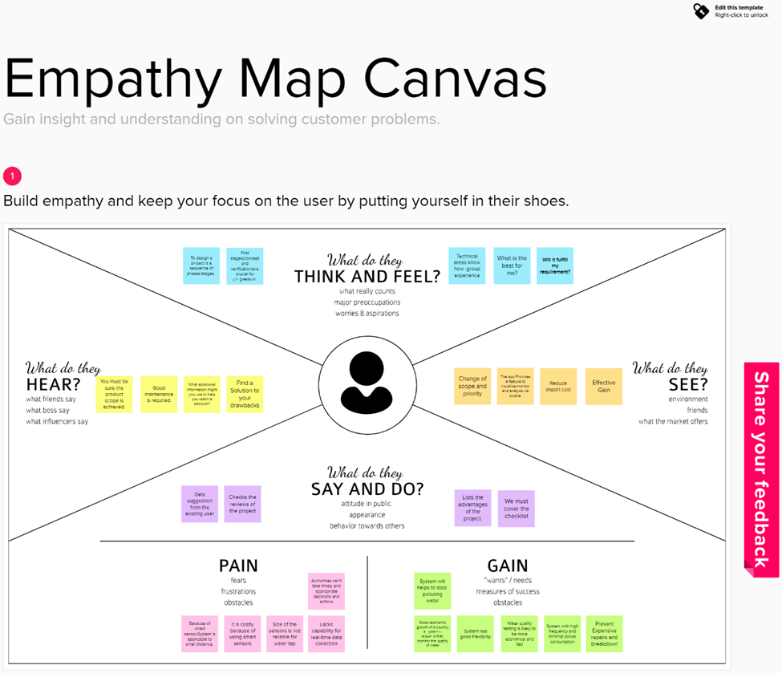
EMPATHY MAP

Slide 7
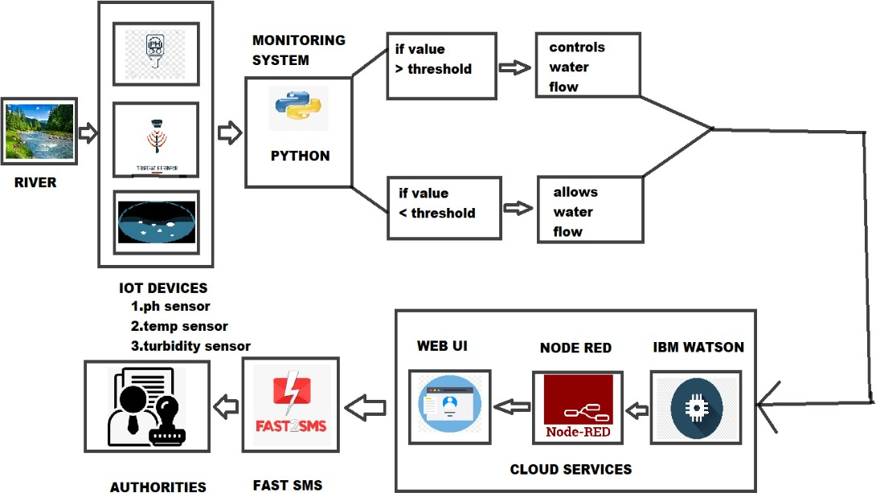
TECHNICAL ARCHITECTURE

Slide 8
REQUIREMENTS
Python
Ibm Watson iot platform
Node-red
Mit app inventer
fast2sms

Slide 9
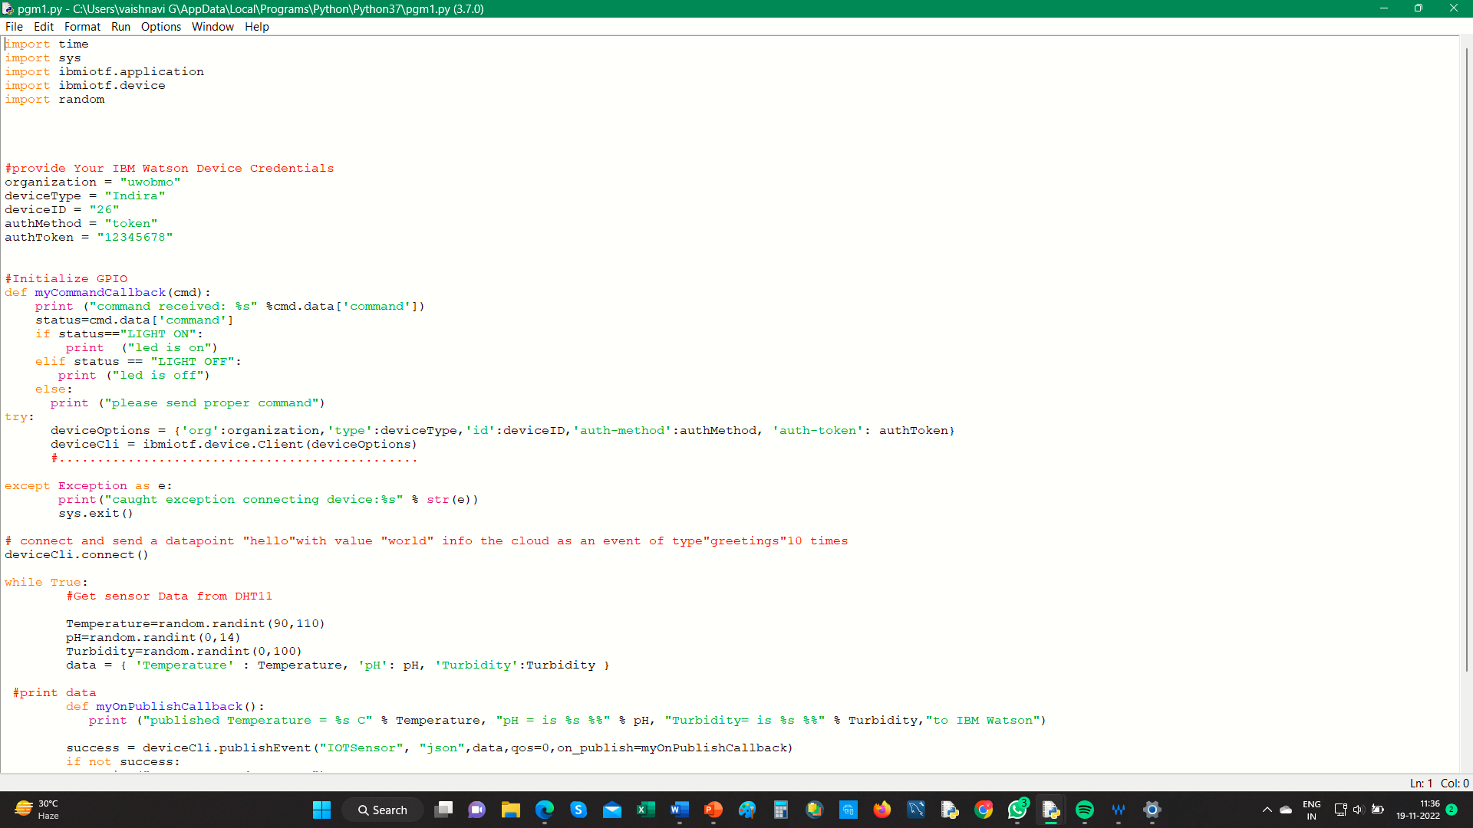
Python code

Slide 10
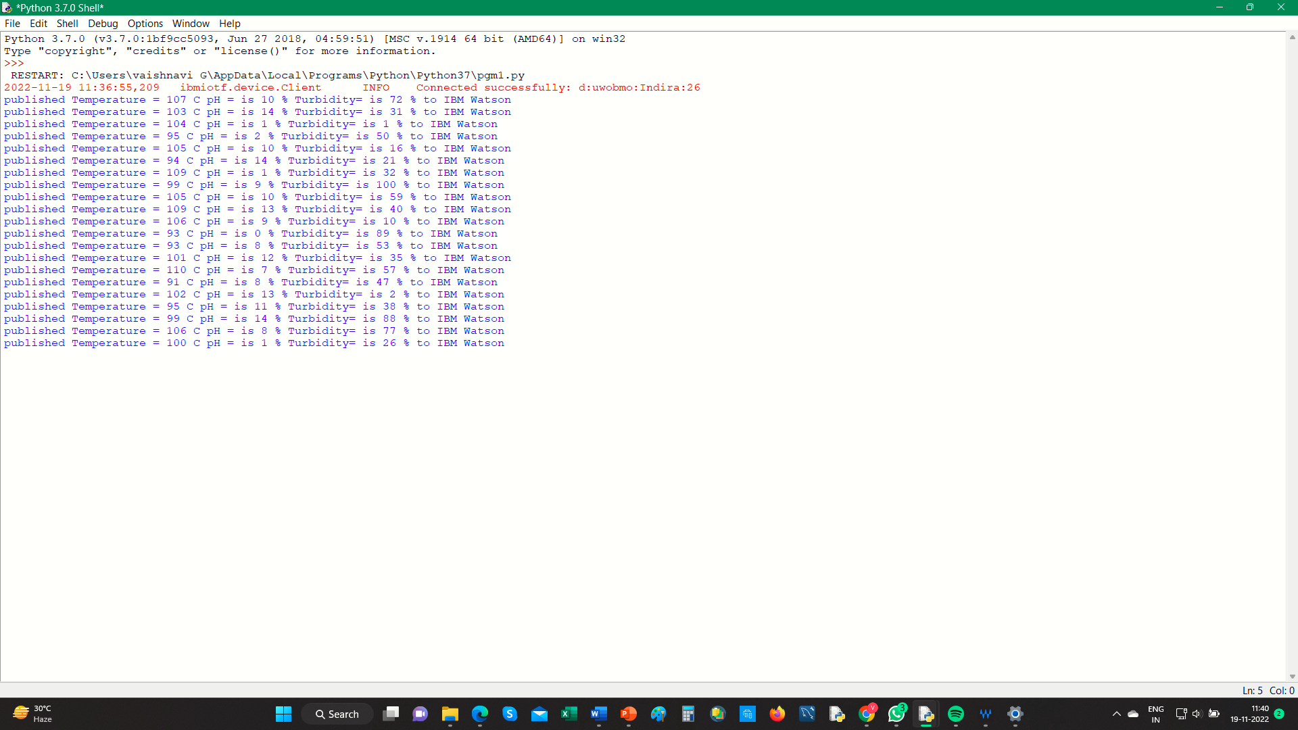
output

Slide 11
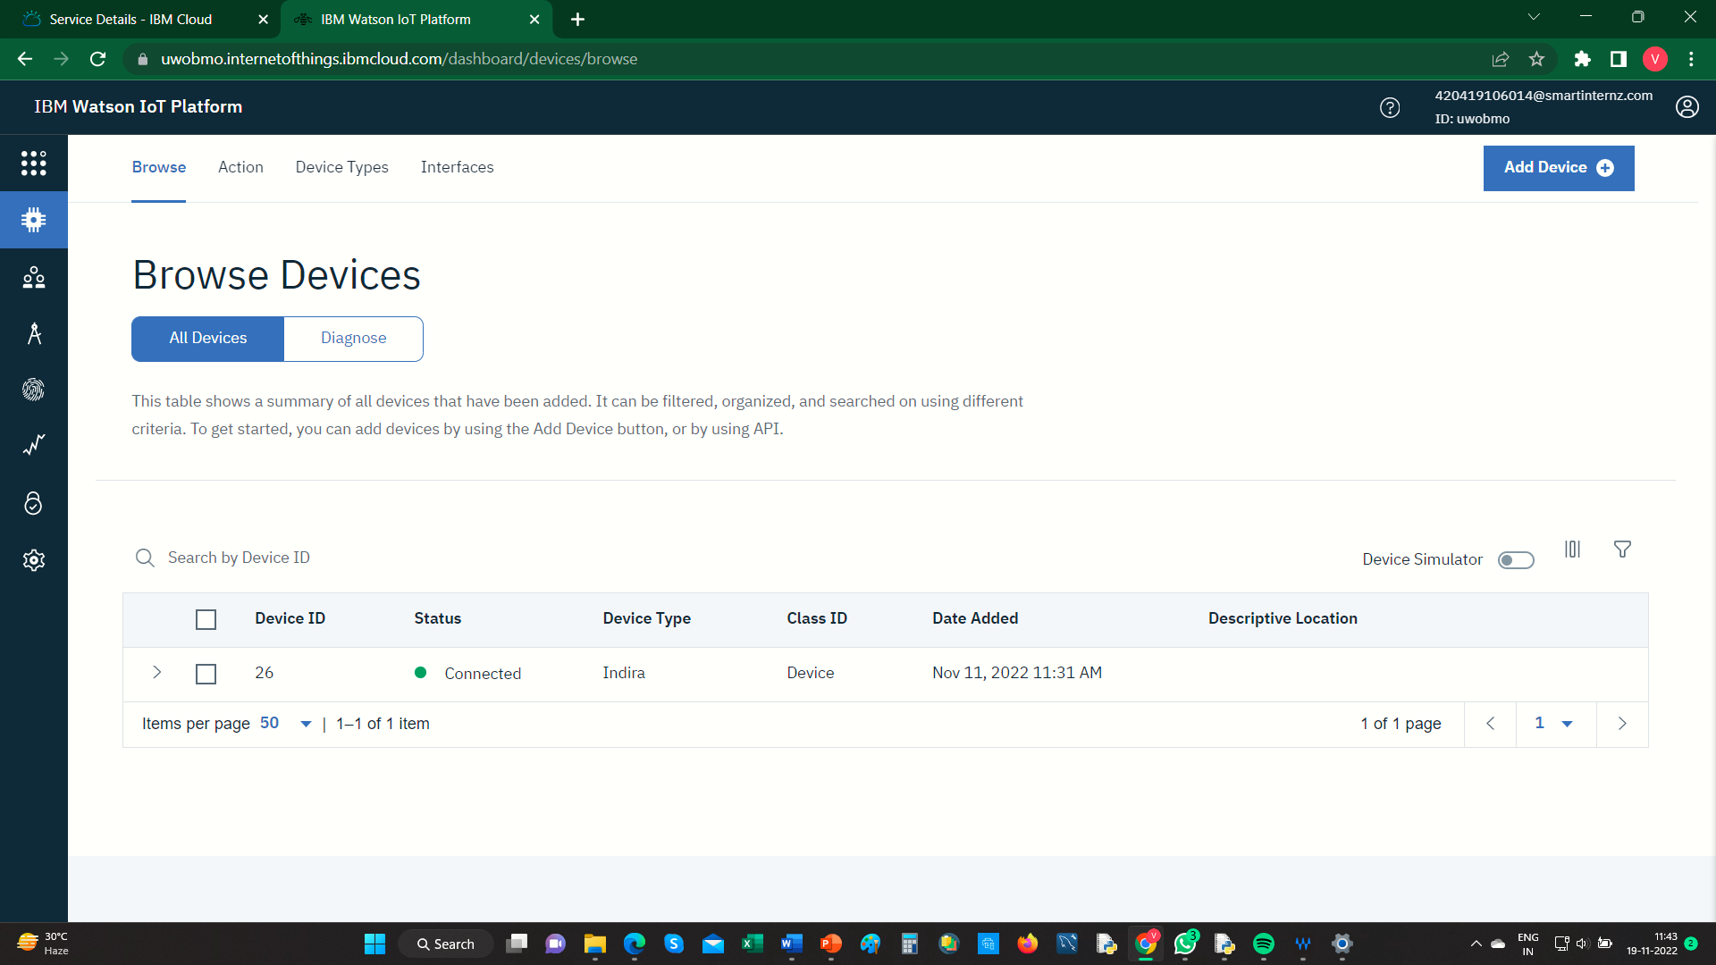
Ibm Watson platform

Slide 12
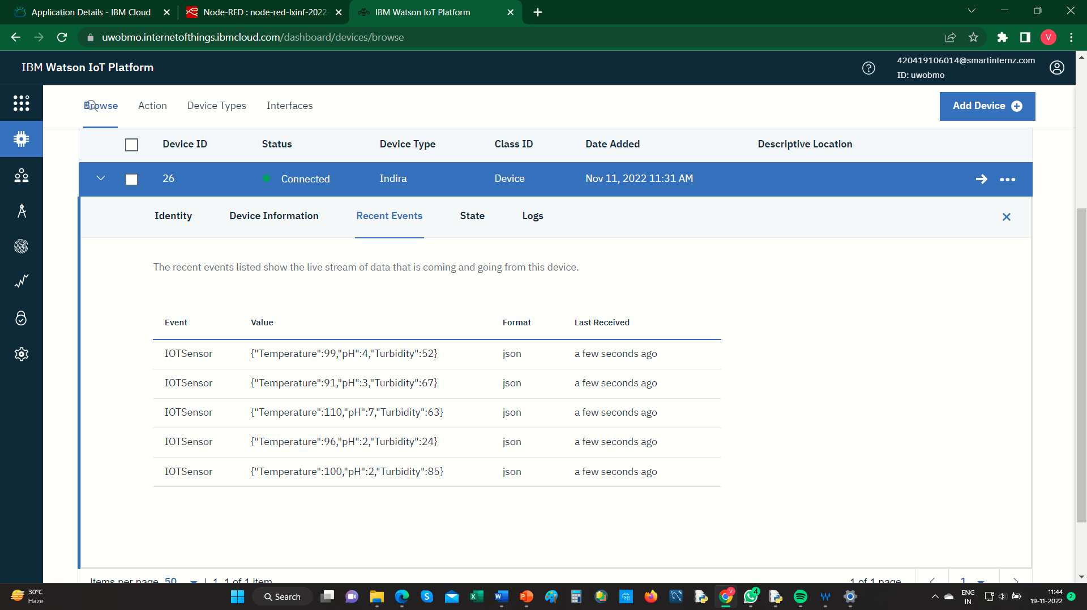
Ibm Watson platform

Slide 13
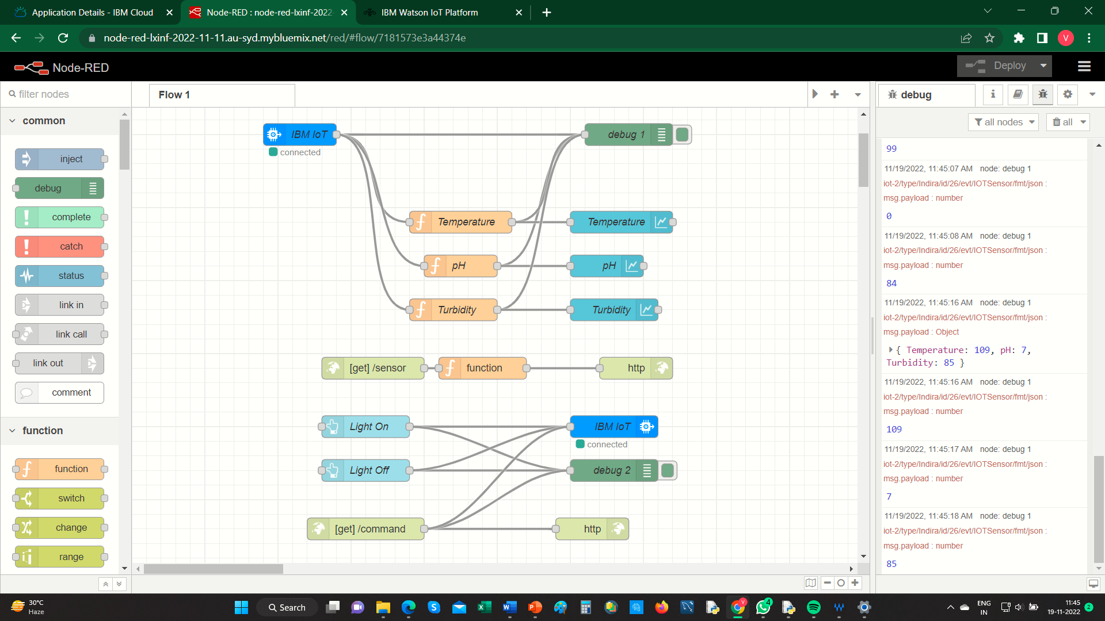
Node-red

Slide 14
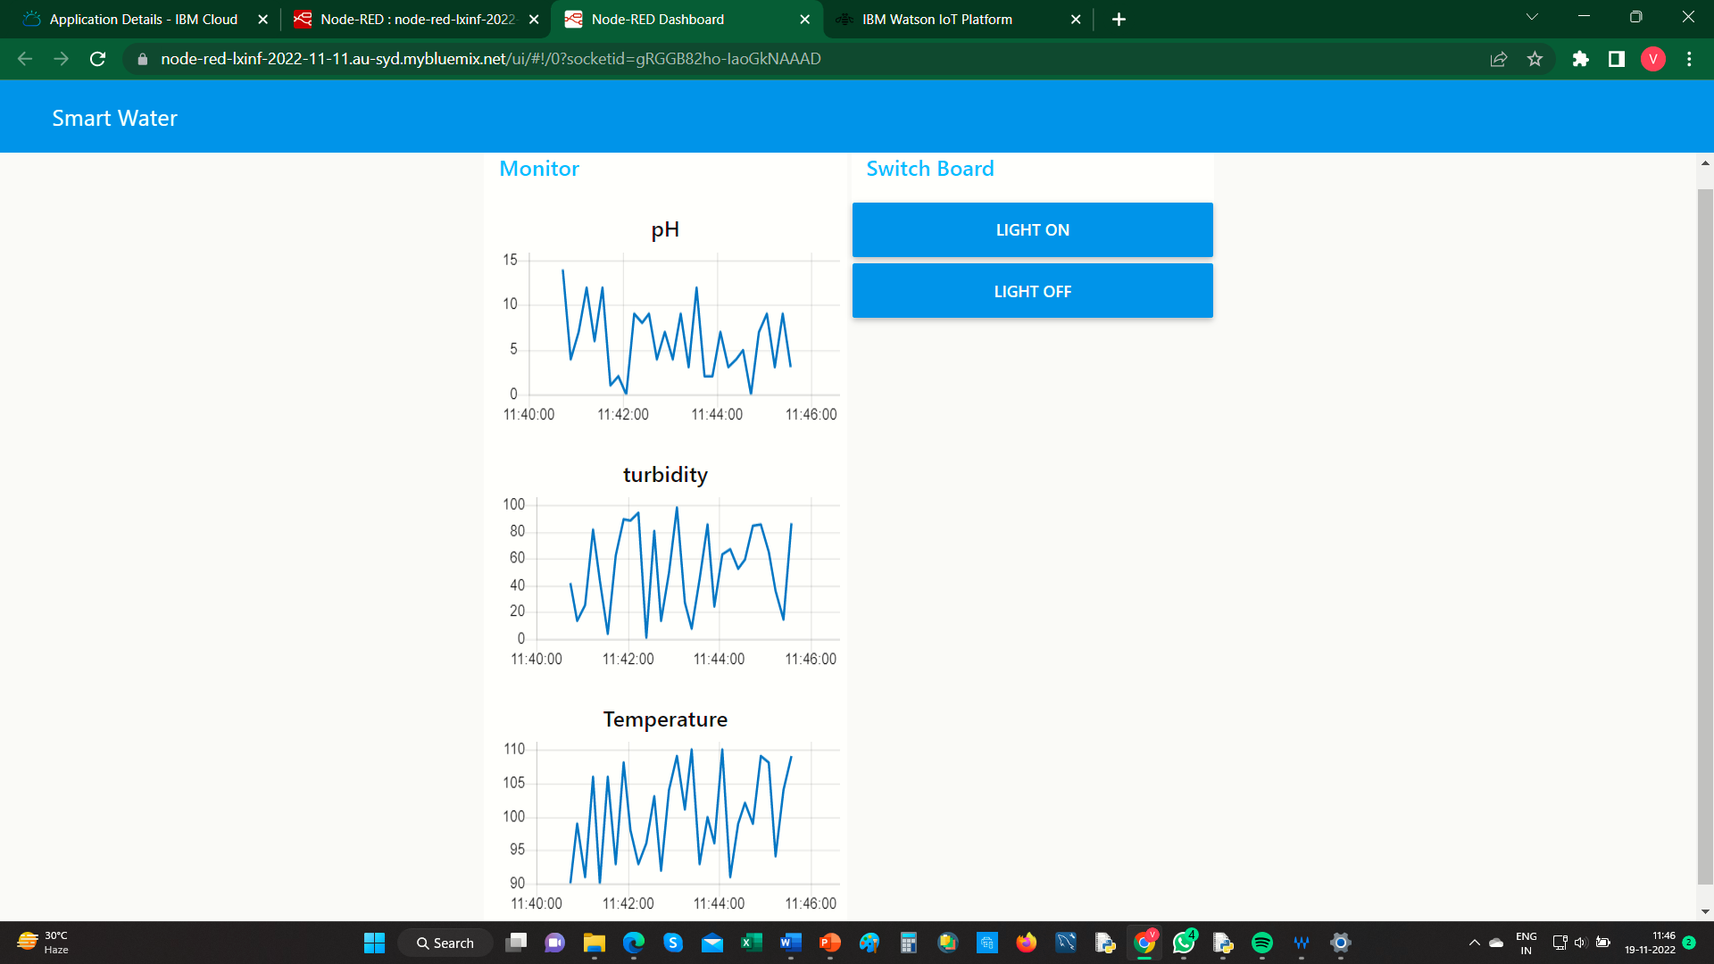
Node-red dashboard

Slide 15
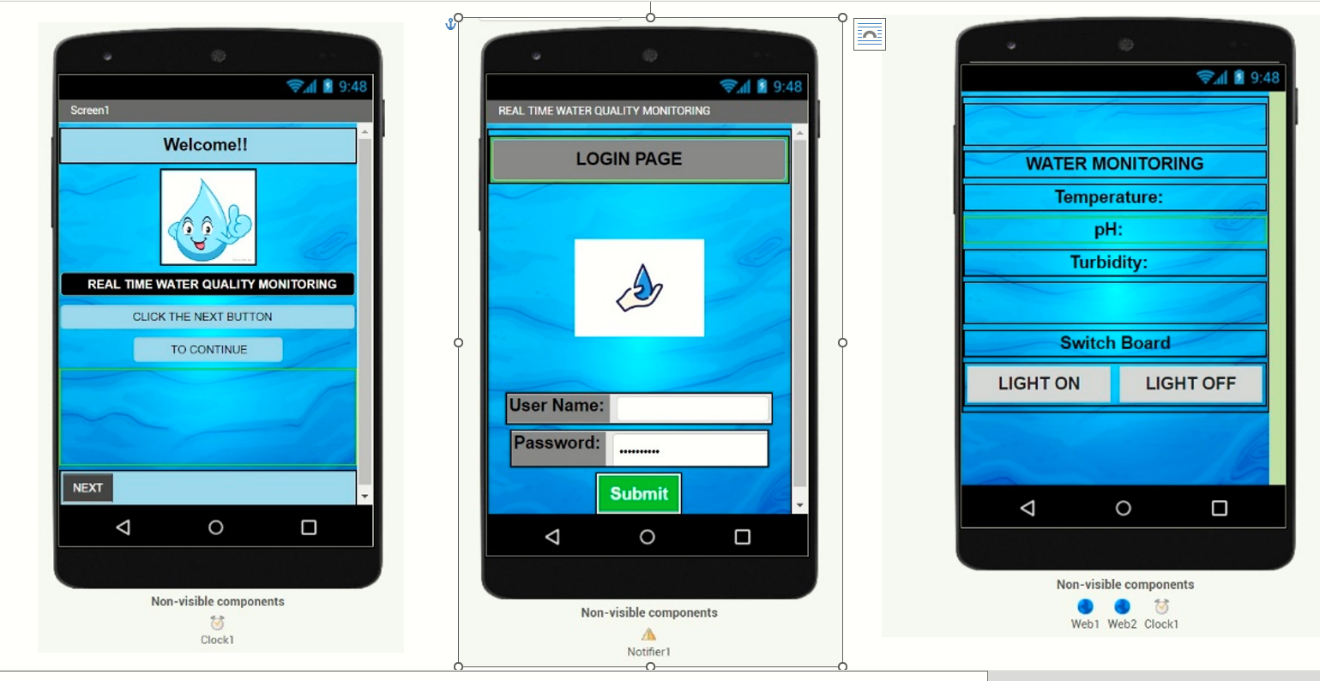
Mit app inventer

Slide 16
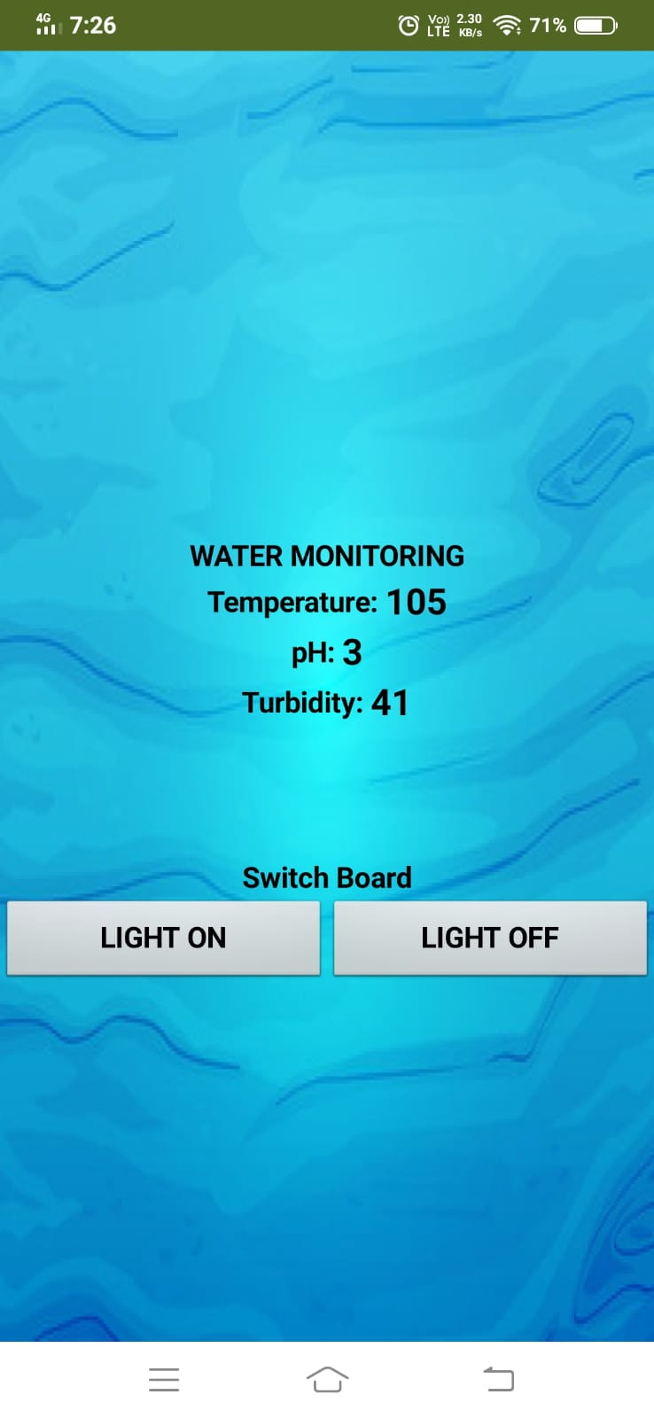
MIT APP INVENTER

Slide 17
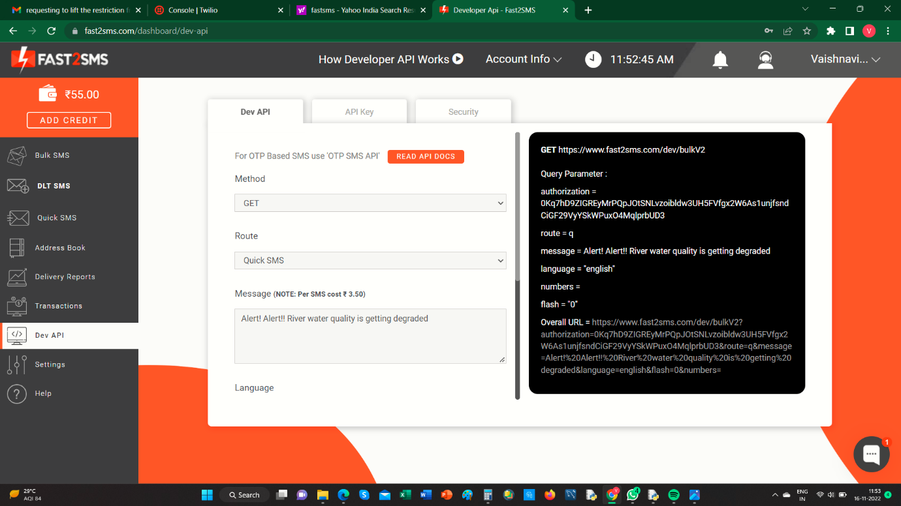
Fast2sms

Slide 18
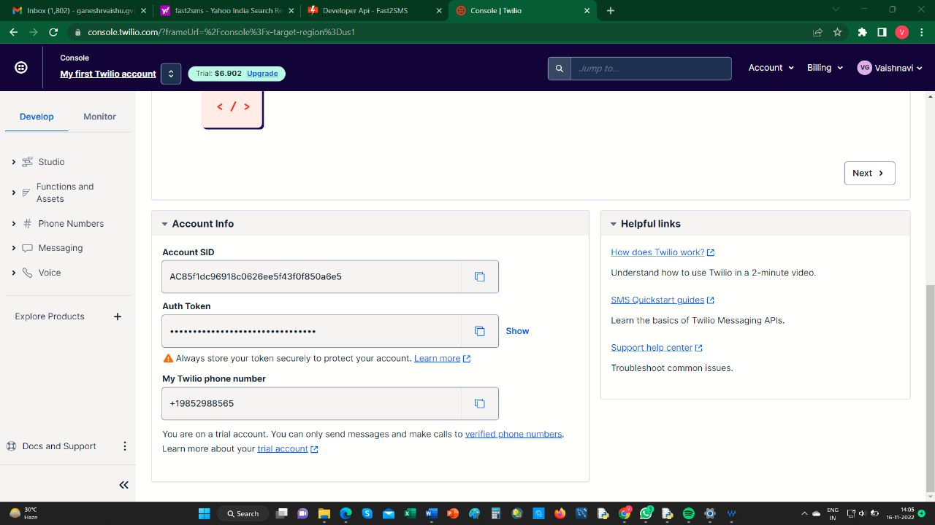
Twilio account

Slide 19
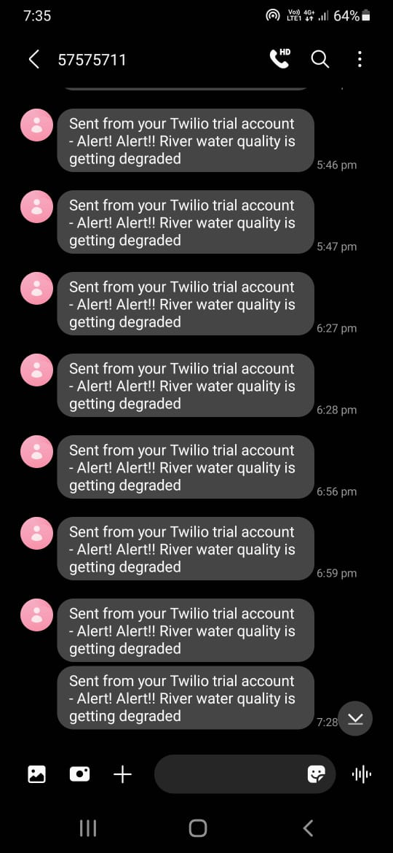
Sms output

Slide 20
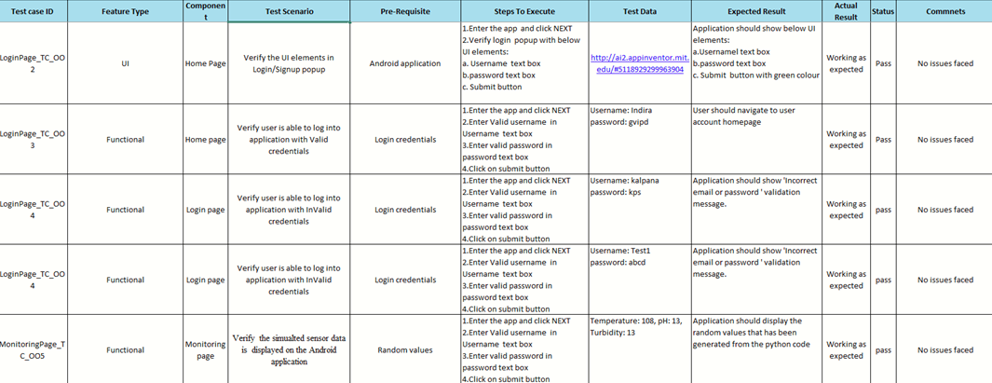
Testing report

Slide 21
ADVANTAGES
Monitoring the water quality in real-time.
Notifying the authority by SMS.
Collecting the information such as Temperature, pH, Turbidity of the river water.
Can view the values by Android application.
User friendly, Easy to handle.

Slide 22
DISADVANTAGES
The project only monitors the water quality, it doesn’t control the water from getting polluted.

Slide 23
CONCLUSION
Therefore the android application has been designed and the Water quality parameters has been displayed in the monitor screen and when the water quality seems to be dTherefore the android application has been designed and the Water quality parameters has been displayed in the monitor screen and when the water quality seems to be degraded the respective authority is being notified about it by sms.egraded the respective authority is being notified about it by sms.

Slide 24
FUTURE SCOPE
In future we can rebuild the project to test for any chemical contamiants and provide solutions to overcome the chemical pollutants in the water.
Environmental water quality monitoring aims to provide the data required for safeguarding the environment against adverse biological effects from multiple chemical contamination arising from anthropogenic diffuse emissions and point sources.
Various water sampling techniques, chemical target, suspect and non-target analyses as well as an array of in vitro, in vivo and in situ bioanalytical methods were advanced to improve monitoring of water contamination.

Slide 25
GITHUB LINK & demo video link
Github link: https://github.com/IBM-EPBL/IBM-Project-14021-1659538996
Demo Video link: https://drive.google.com/file/d/16MgFyCdwpLmEq4lU61V-jVuWgkHA6msP/view?usp=share_link

Slide 26
THANK YOU!

